Slide 1
Title – Salary Prediction
By
Pranit Pisal

Slide 2

Objective
To predict the Salary using Work experience

Slide 3

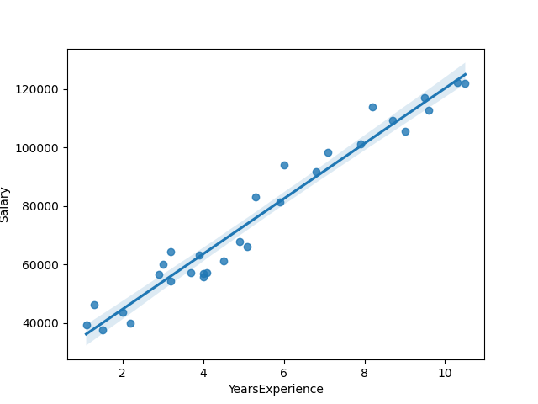
Solution
Doing EDA on current dataset.
Using Linear regression over the current data.
Analysing the insights and Graph patterns.

Slide 4


Business Impact
This solution will help in assigning salary to new employees based on their work experience and helps in defining salary as the job experience increases.

